Slide 1

BI Project
By Rotem Hazan

Slide 2
Part A:
Part A in this project includes an explanation about: * our company * The 2 databases that we used *We did a star schema and chose a fact table or a dim table – and for the dimension table we defined if the table is SCD (slowly changing dimension) and for which kid. *We defined the KPI of the company

Slide 3
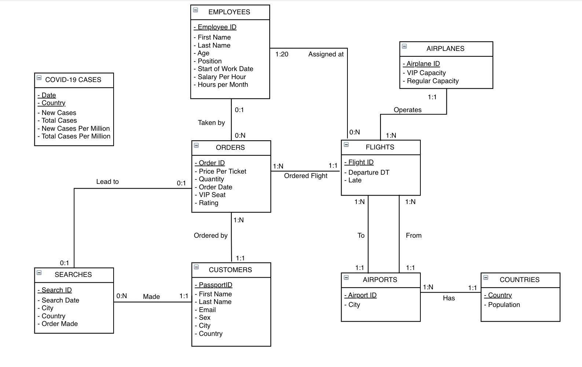
ERD Schema

Slide 4
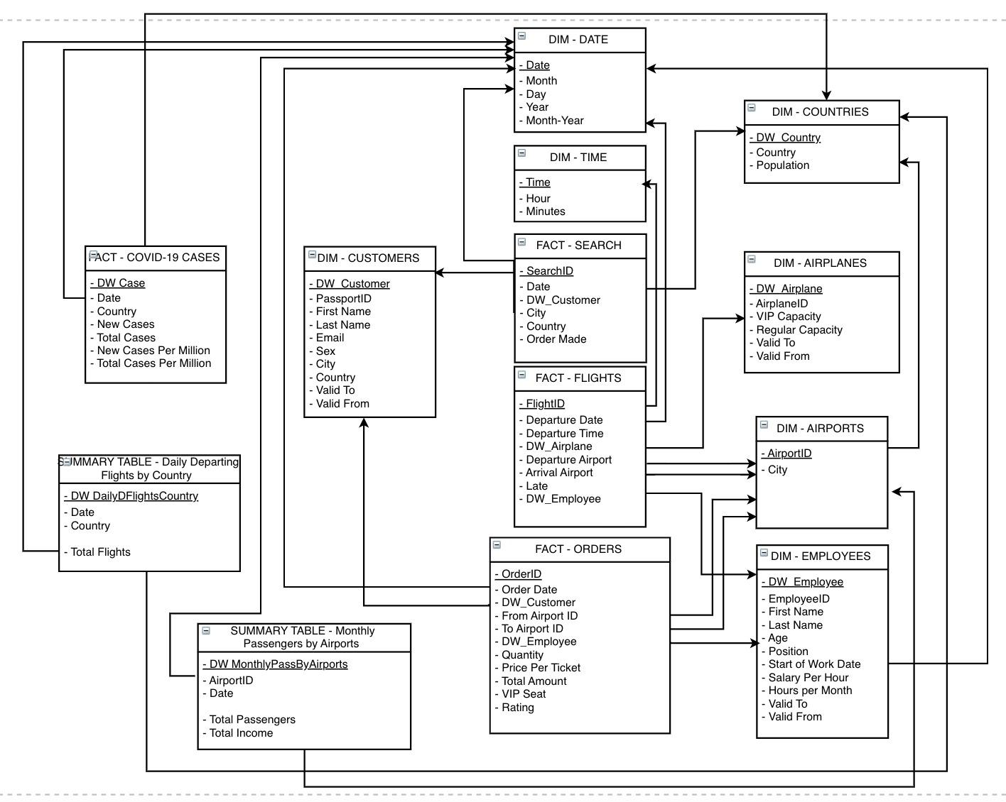
Star schema

Slide 5
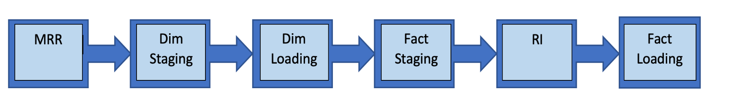
Part B:
In part b we did the:
ETL process – creates the MRR , STG and DW databases
did the 2 attitudes of RI process
Change one of the dim tables to slowly changing dimensions type 2 and created a process in tableau prep

Slide 6
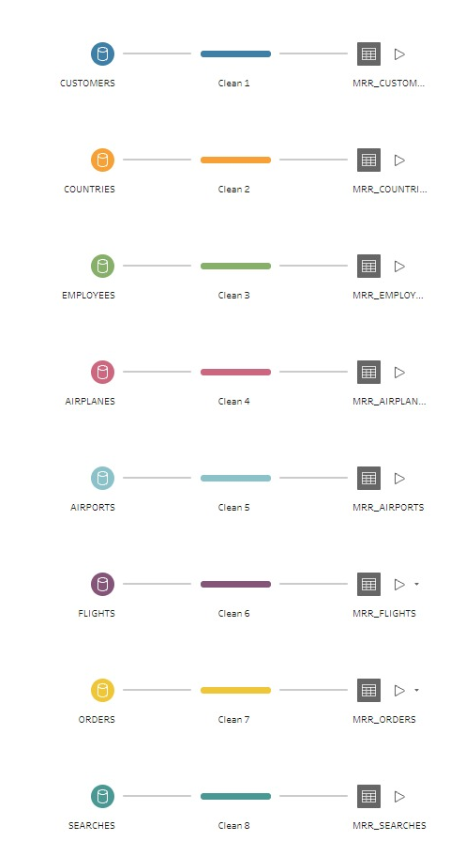
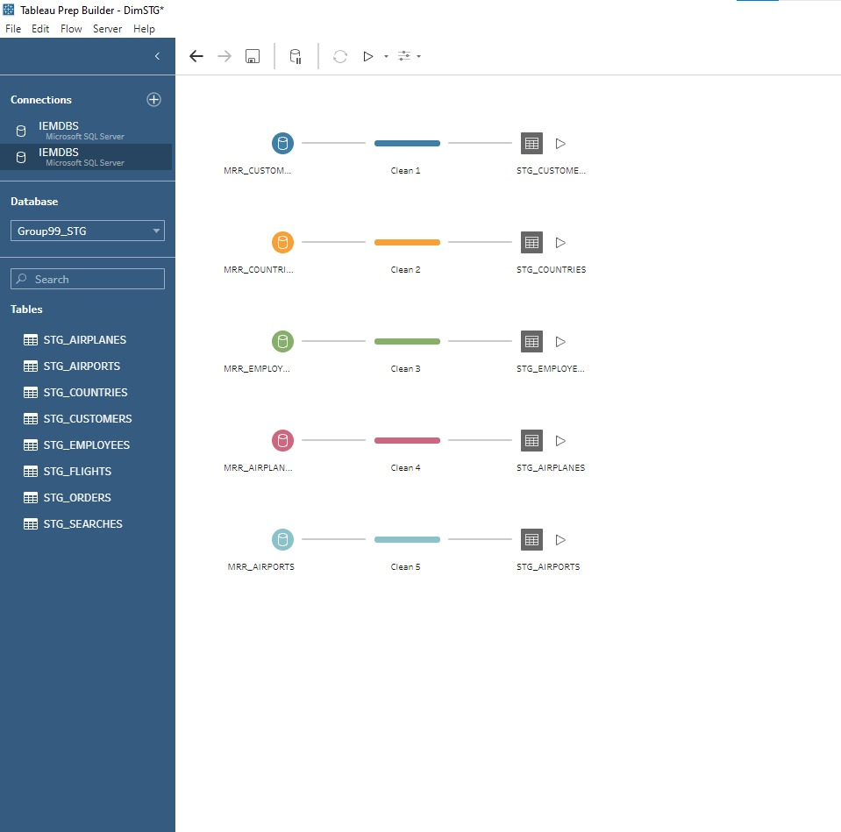
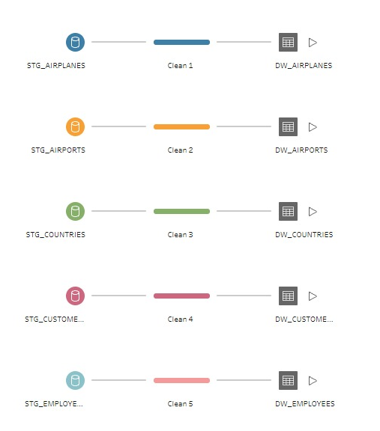
MRR
Dim staging
Dim Loading

Slide 7
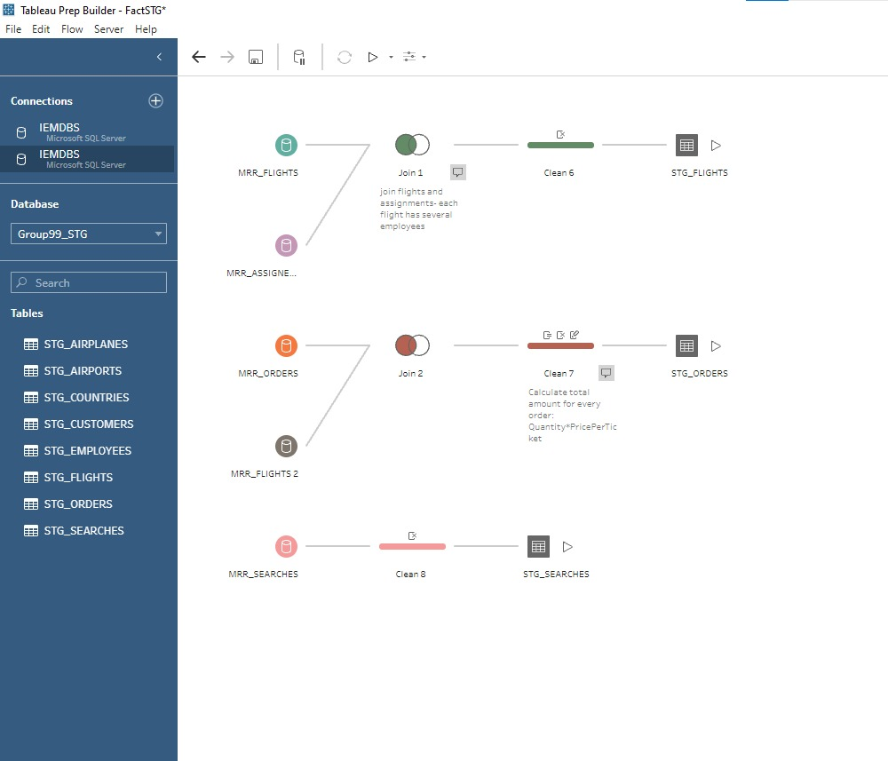
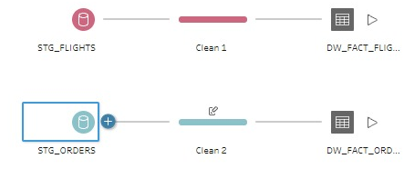
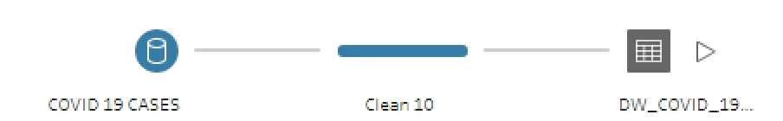
Fact staging
Fact Loading
RI

Slide 8
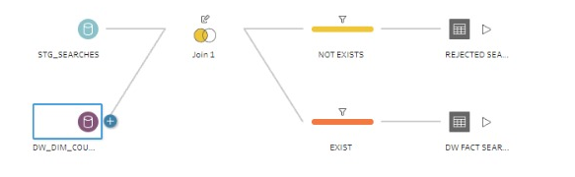
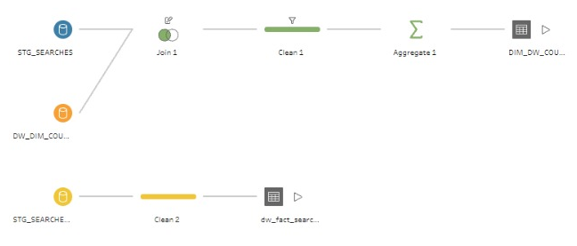
RI attitudes
First attitude :
* Second attitude:
Add explain

Slide 9
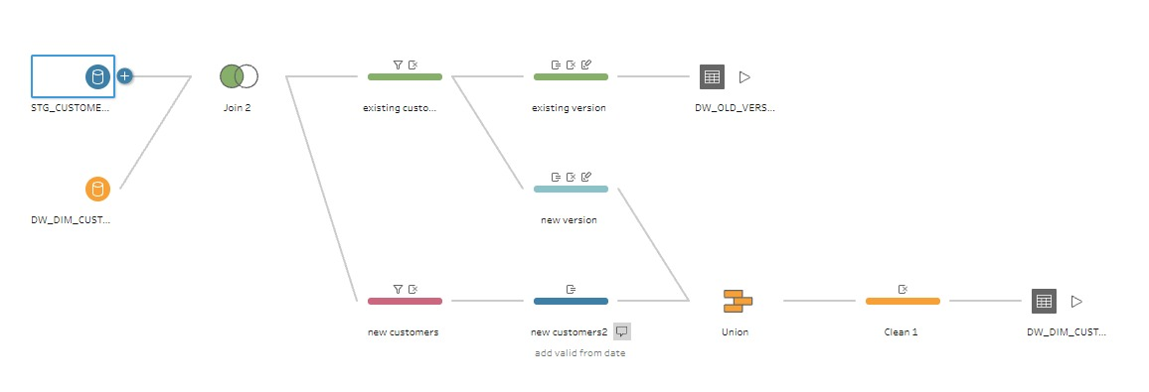
slowly changing dimensions type 2
Add explain : use procedure that update the last date of this row and delete old version

Slide 10
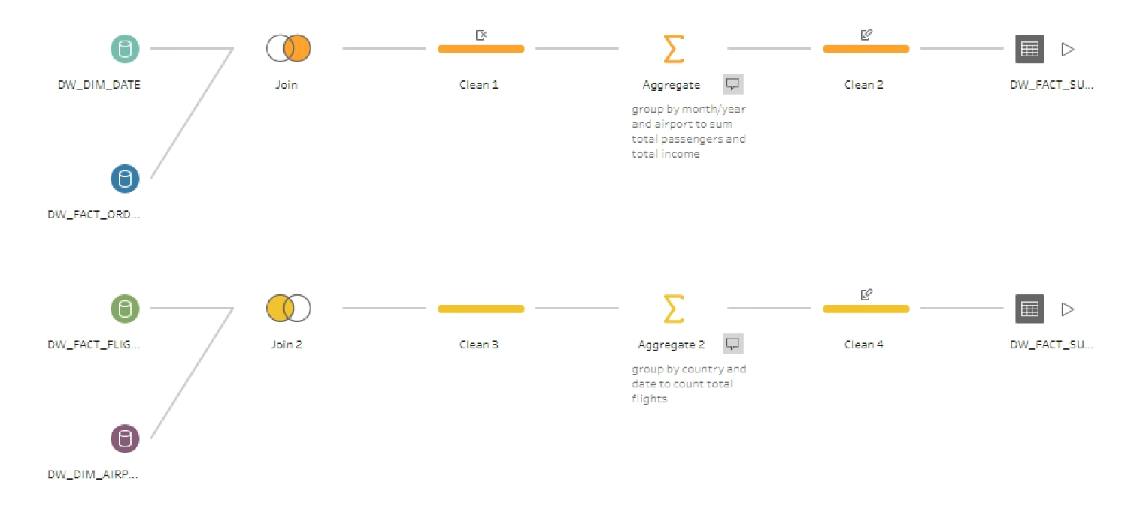
Summary Tables:
Summary of amount customers that landed in airports by month
Summary of amount departures from all the countries

Slide 11
Part c:
This part references to BI&A – so we made some of dashboards:
2 Business report
Digital Dashboard
OLAP – On-Line Analytical Processing
2 dashboards that used as extensions tools of tableau

Slide 12
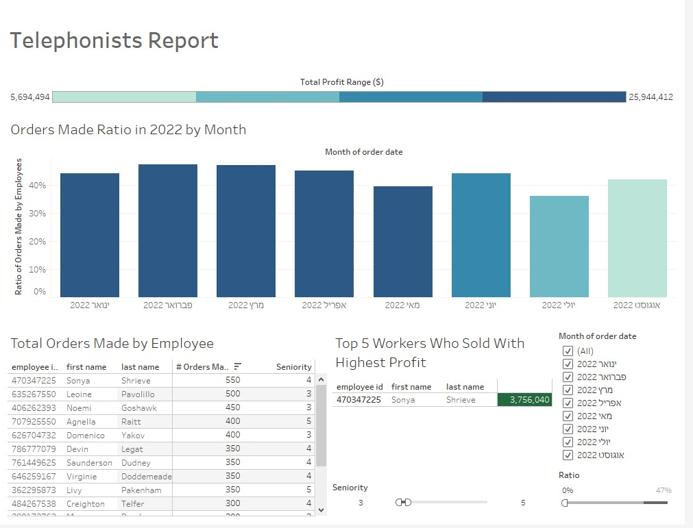
Answer the questions how many new employees do we want to require?

Slide 13
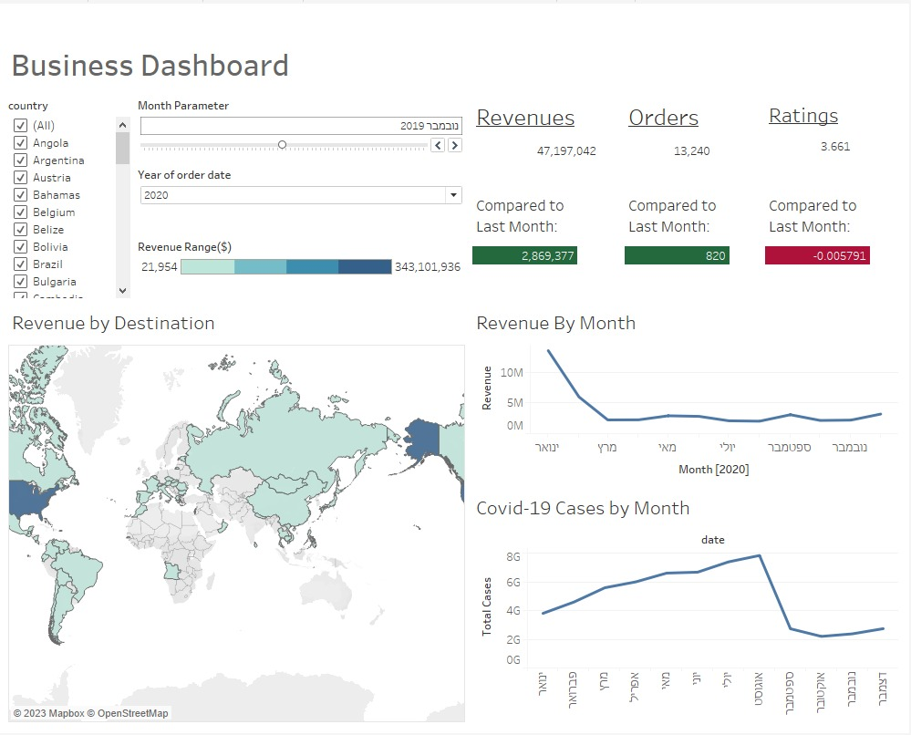
For the CEO. We can see the revenue, number of orders , average rate

Slide 14
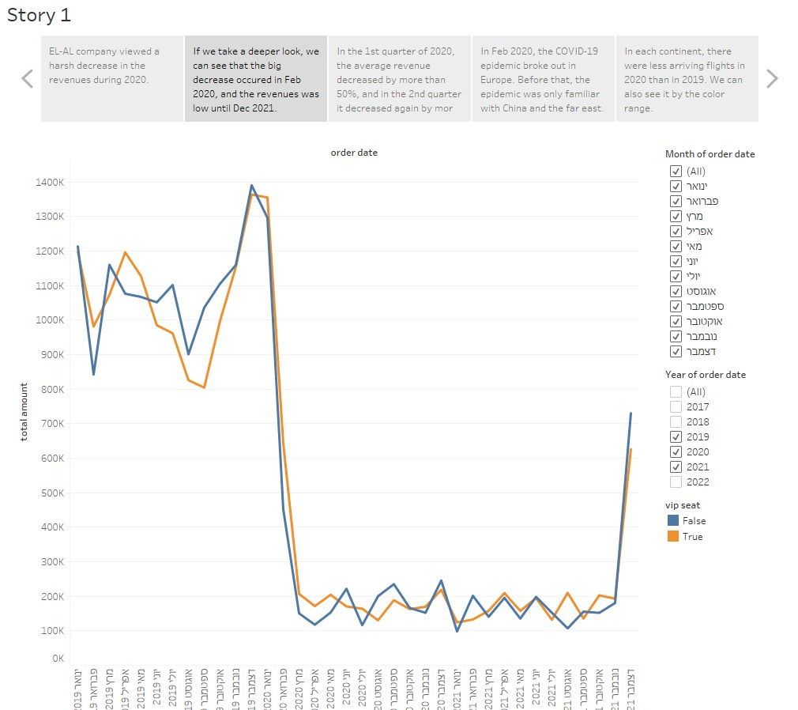
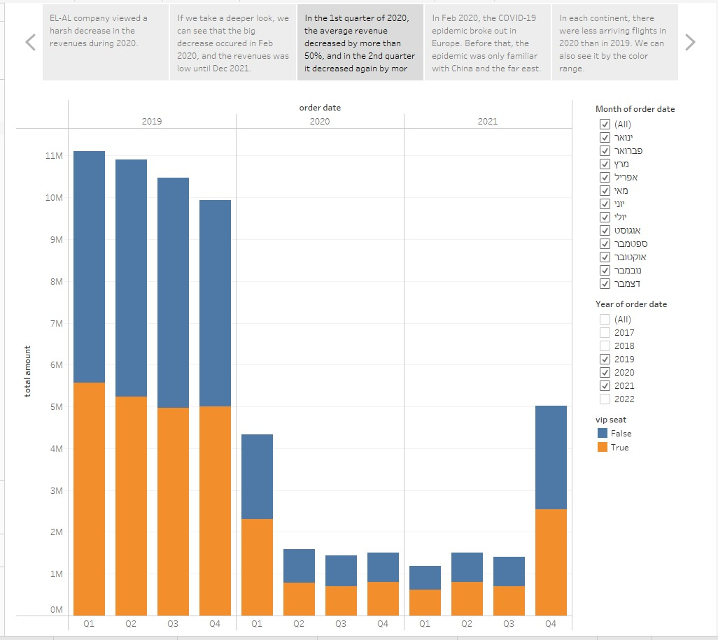
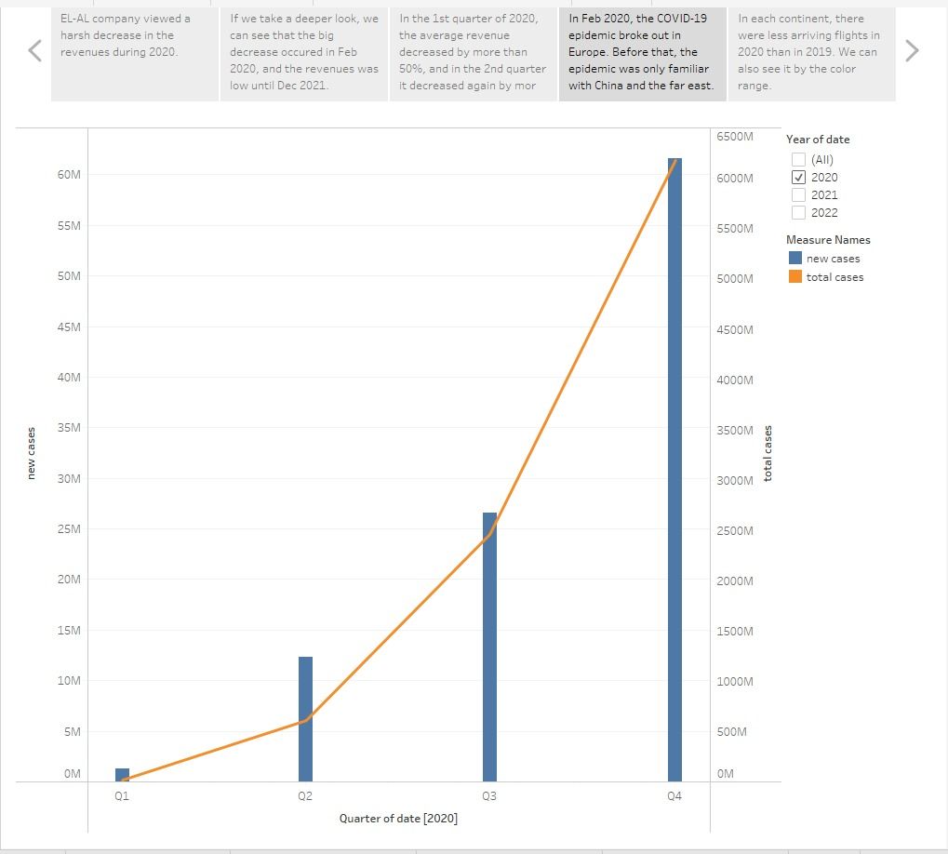
OLAP – with data storytelling

